Slide 1
TELECOM CUSTOMER CHURN PREDICTION 📈
Did you know that attracting a new customer costs five times as much as keeping an existing one?

Slide 2
Introduction
What is Customer Churn?
Customer churn is defined as when customers or subscribers discontinue doing business with a firm or service.
Customers in the telecom industry can choose from a variety of service providers and actively switch from one to the next. The telecommunications business has an annual churn rate of 15-25 percent in this highly competitive market.
To reduce customer churn, telecom companies need to predict which customers are at high risk of churn.

Slide 3
Objectives
What's the % of Churn Customers and customers that keep in with the active services?
Is there any patterns in Churn Customers based on the gender?
Is there any patterns/preference in Churn Customers based on the type of service provided?
What's the most profitable service types?
Which features and services are most profitable?
Many more questions that will arise during the analysis

Slide 4
3.Understanding the Data
The data set includes information about:
Customers who left within the last month – the column is called Churn
Services that each customer has signed up for – phone, multiple lines, internet, online security, online backup, device protection, tech support, and streaming TV and movies
Customer account information - how long they’ve been a customer, contract, payment method, paperless billing, monthly charges, and total charges
Demographic info about customers – gender, age range, and if they have partners and dependents

Slide 5
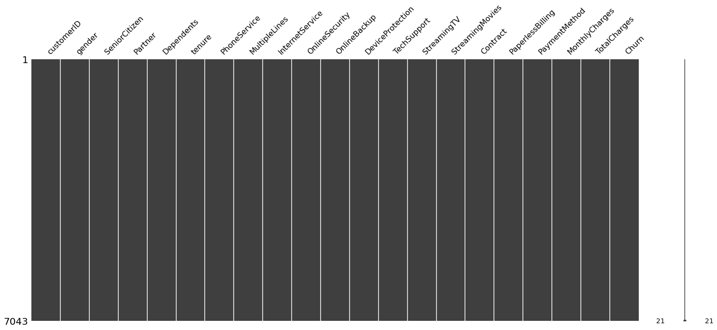
4.Visulizing Missing Values

Slide 6
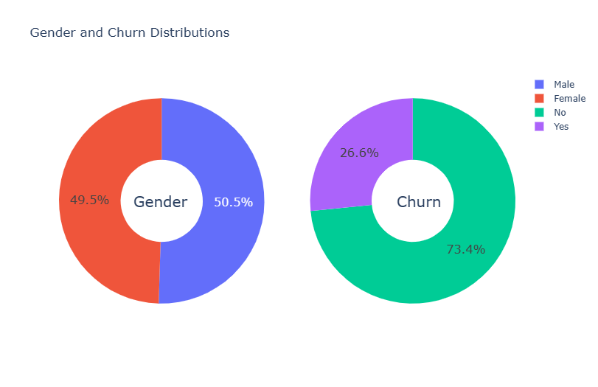
6.Data Visulization

Slide 7
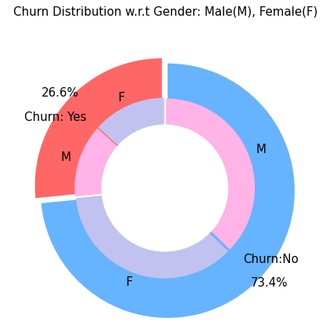
Churn Distribution w.r.t Gender:Male(M),Female(F)
There is negligible difference in customer percentage/ count who chnaged the service provider. Both genders behaved in similar fashion when it comes to migrating to another service provider/firm.

Slide 8
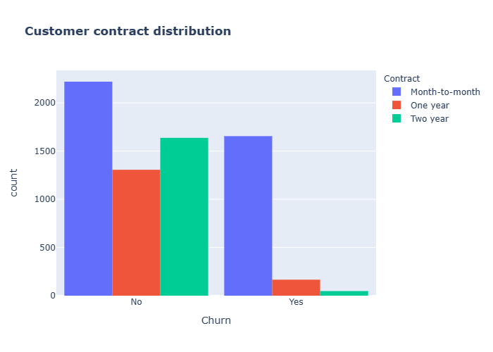
Customer Contact Distribution
About 75% of customer with Month-to-Month Contract opted to move out as compared to 13% of customrs with One Year Contract and 3% with Two Year Contract

Slide 9
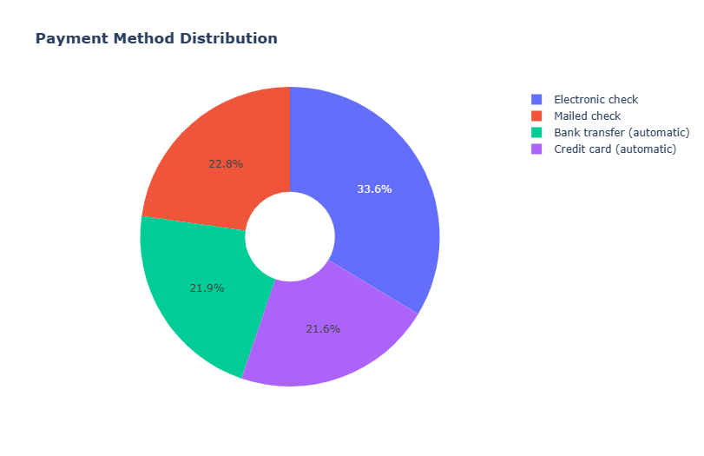
Payment Method Distribution

Slide 10
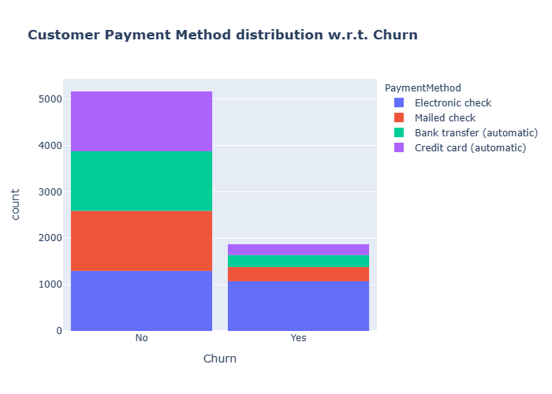
Customer Payment Method Dist. W.r.t Churn
Major customers who moved out were having Electronic Check as Payment Method.
Customers who opted for Credit-Card automatic transfer or Bank Automatic Transfer and Mailed Check as Payment Method were less likely to move out.

Slide 11
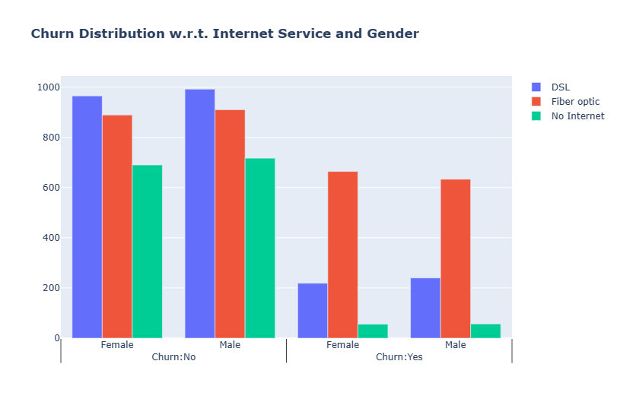
Churn Dist. W.r.t. InternetService and Gender
A lot of customers choose the Fiber optic service and it's also evident that the customers who use Fiber optic have high churn rate, this might suggest a dissatisfaction with this type of internet service.
Customers having DSL service are majority in number and have less churn rate compared to Fibre optic service.

Slide 12
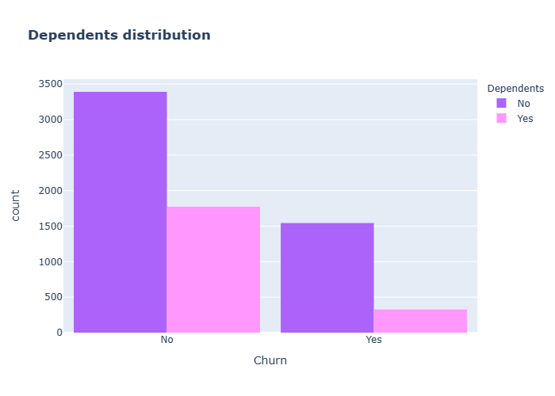
Depedants Distributions
Customers without dependents are more likely to churn

Slide 13
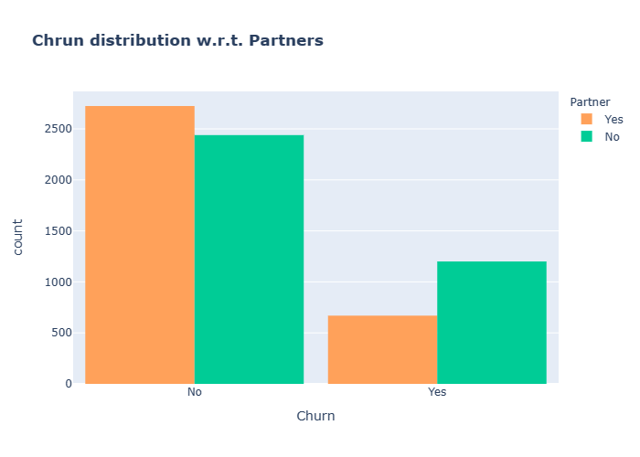
Churn distributions W.r.t. Partners
Customers that doesn't have partners are more likely to churn

Slide 14
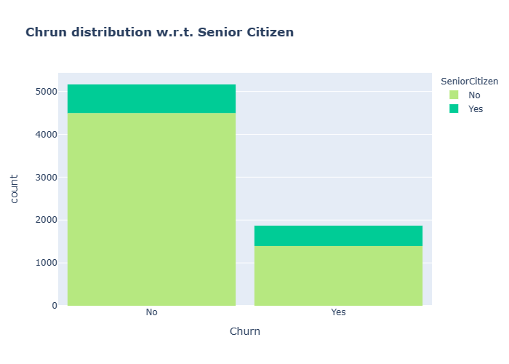
Churn distributions W.r.t. Senior Citizen
It can be observed that the fraction of senior citizen is very less.
Most of the senior citizens churn.

Slide 15
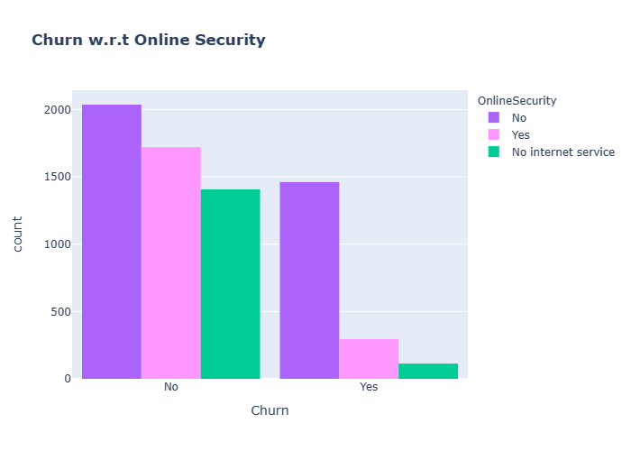
Churn W.r.t. Security
Most customers churn in the absence of online security,

Slide 16
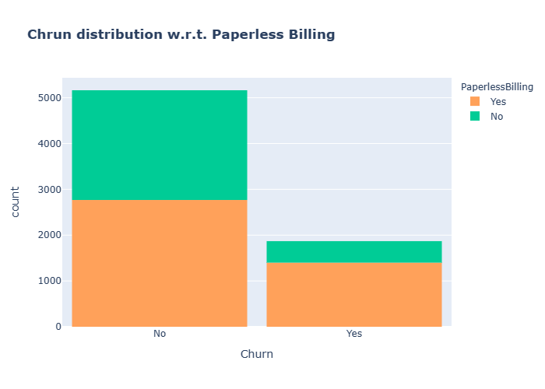
Churn distributions W.r.t. Papaerless Billing
Customers with Paperless Billing are most likely to churn.

Slide 17
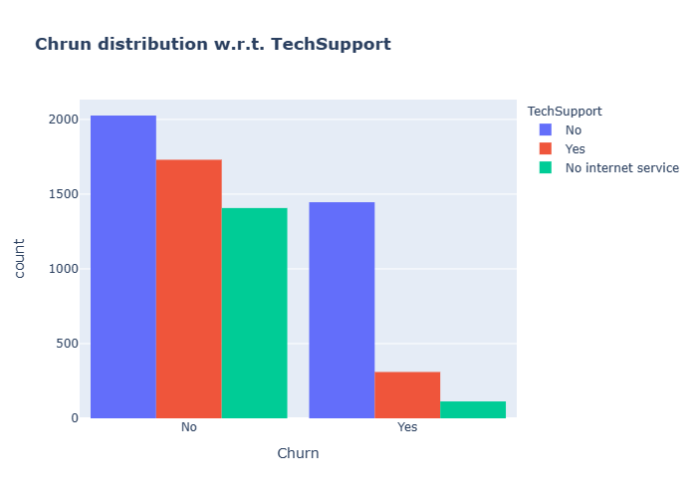
Churn Distributions W.r.t. Tech Support
Customers with no TechSupport are most likely to migrate to another service provider.

Slide 18
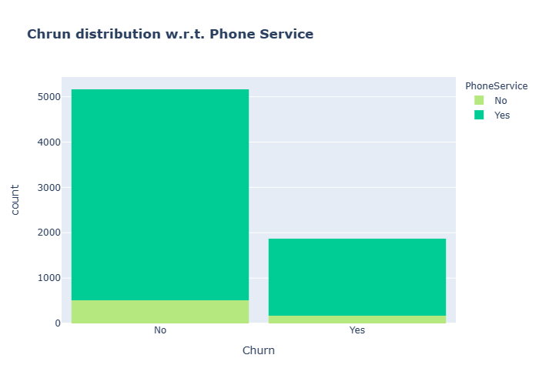
Churn Distributions W.r.t. Phone Service
Very small fraction of customers don't have a phone service and out of that, 1/3rd Customers are more likely to churn.

Slide 19
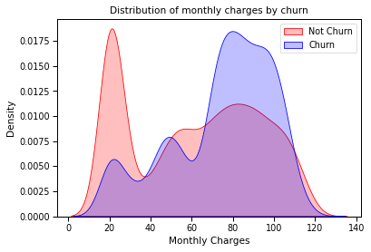
Distribution of Monthly Charges by Churn
Customers with higher Monthly Charges are also more likely to churn

Slide 20
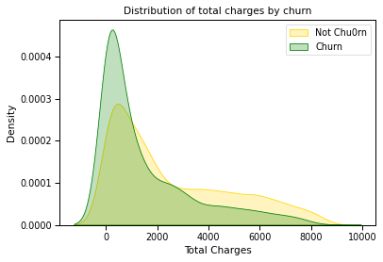
Distributions of Total Charges by Churn

Slide 21
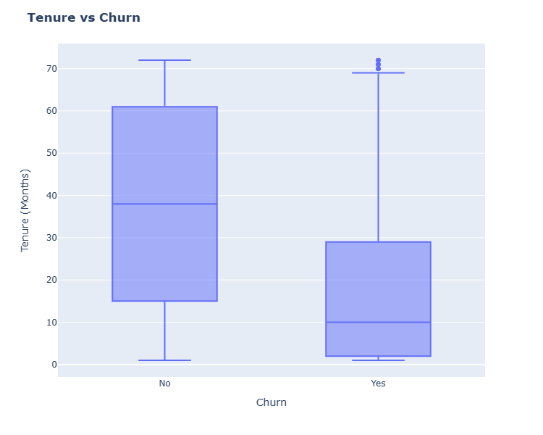
Tenure VS Churn
New customers are more likely to churn

Slide 22
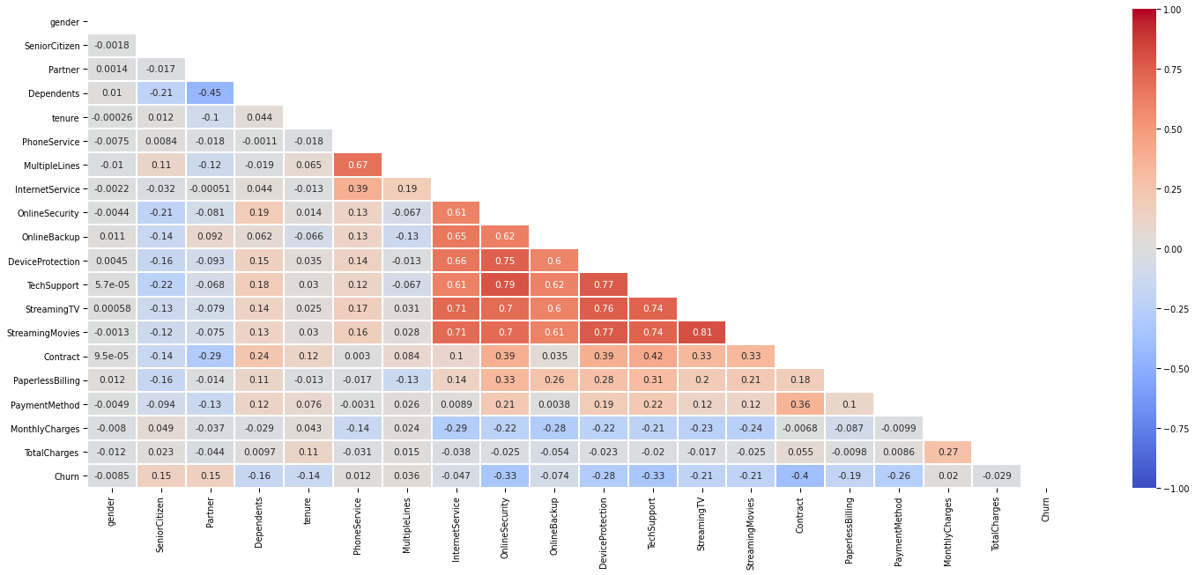
Total Relation

Slide 23
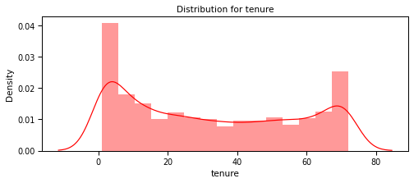
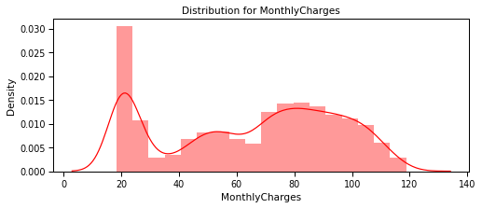
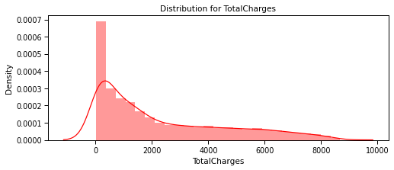
Data Preprocessing

Slide 24
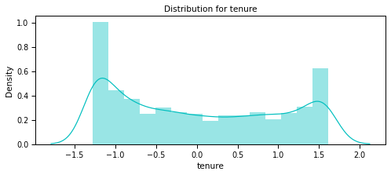
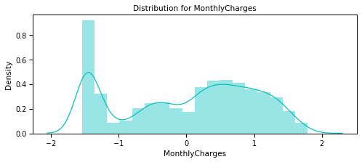
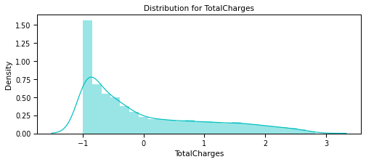
Standardizing numeric attributes

Slide 25
8. Machine Learning Model Evaluations and Predictions
Machine Learning Algorithms | Accuracy Score | Confusion Matrix
KNN | 77% | array([[1346, 269], [ 203, 292]],
SVC | 80.75%
Random Forest | 81% | [1432, 117 276, 285]
Logistic Regression | 80.90 | [1380,169 234,327]
Decision Tree | 72.98%
AdaBoost | 80.75 | [1398,151 255,306]
GradientBoost | 80.80 | [1396,153 252,309]
VotingClassifier(final_classifier) | 81.70 | [1396,153 252,309]

Slide 26
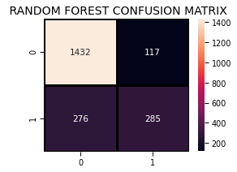
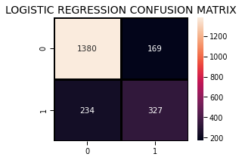
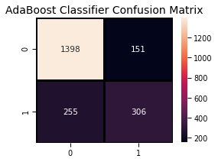
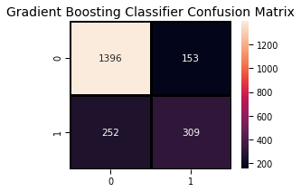
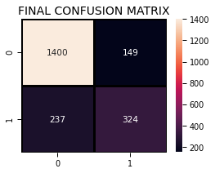
Confusion Matrix

Slide 27
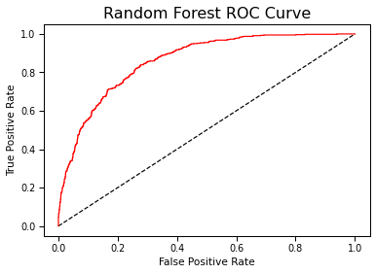

Roc Curve

Slide 28
Conclusion
From the confusion matrix we can see that: There are total 1400+149=1549 actual non-churn values and the algorithm predicts 1400 of them as non churn and 149 of them as churn.
While there are 237+324=561 actual churn values and the algorithm predicts 237 of them as non churn values and 324 of them as churn values.

